Slide 1

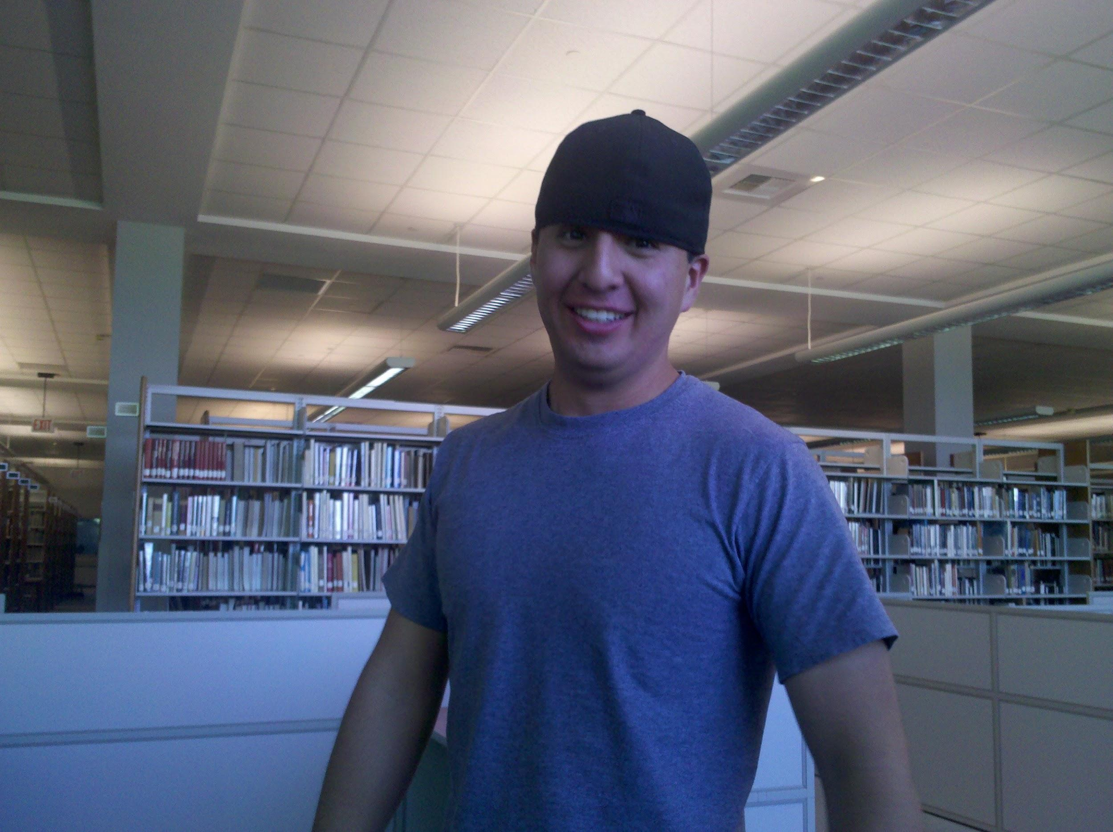
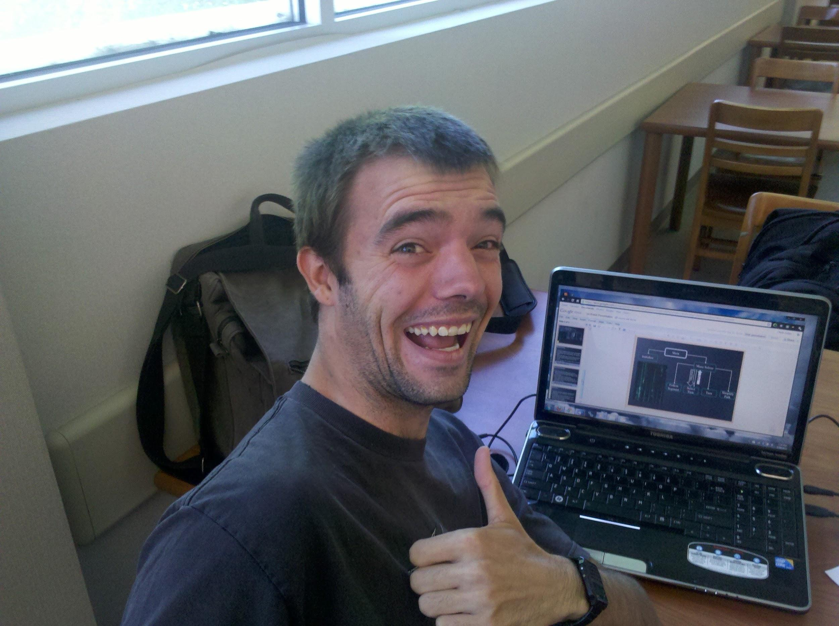
~9.42 oz. Burger
or
"Would you like fries with that?
by 6arcsin(1)
Notes:
Names subject to change... but we introduce ourselves. Make it fun though.
suggest some names:
3(arcos(-1)) {something that =3pi} also 3* sqrt(-1) / ln(-1)
2 1/2 men :D
(something including the robot as a team member, I.E. 3 guy and a droid)

Slide 2

Problem Statement
Optimize the maze-solving program for the Pololu 3pi Robot in order to maneuver a maze (with no loops) in the fastest time possible.
We were given an assortment of code to which we were charged with manipulating and organizing in order to make the 3pi robot function with the line maze objective.
Notes:
Brief screenshots of both codes, perhaps.
This-to-this, kind of thing...

Slide 3
Robot Description
-with features
The Pololu 3pi robot is a complete, high-performance mobile platform featuring two micro metal gearmotors, five reflectance sensors, an 8×2 character LCD, a buzzer, and three user pushbuttons, all connected to a C-programmable ATmega328 microcontroller. Capable of speeds exceeding 3 feet per second, 3pi is a great first robot for ambitious beginners and a perfect second robot for those looking to move up from non-programmable or slower beginner robots.

Slide 4
Guidelines
1.A robot may not injure a human being or, through inaction, allow a human being to come to harm.
2.A robot must obey any orders given to it by human beings, except where such orders would conflict with the First Law.
3.A robot must protect its own existence as long as such protection does not conflict with the First or Second Law.

Slide 5
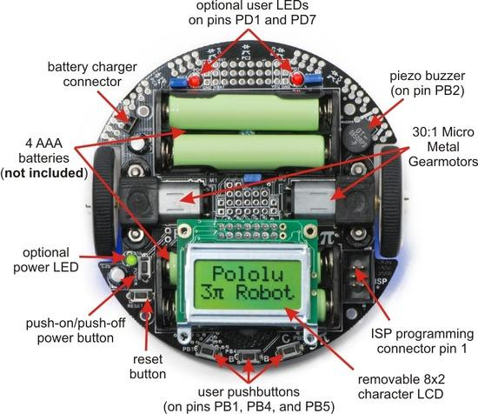
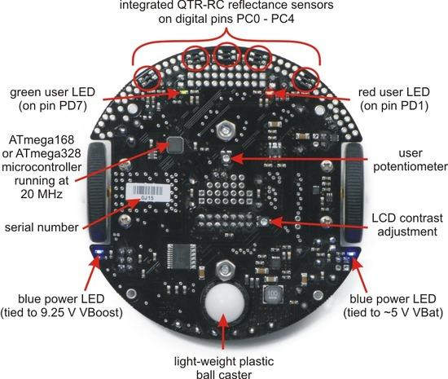

Slide 6
Code Description:
The code is written in the C programming language.
Maze solver follows the line and detects a turn
Line follower follows a black line, adjusting motor speeds based on the change in sensor readings
When an intersection is detected, the robot will choose left the first run through the maze.
The turns are stored in an array, and the total angle of the turns are used to find the correct direction to turn for the second run through the maze in order to find the shortest and fastest path to the end of the maze.

Slide 7
Code Description: cont.
Functions:
initialize
load custom characters
Display readings
maze solve
follow segment
display path
select turn
simplify path
turn
Notes:
should we go though once taking three in a row, or three times taking one at a time? smoother to do 3.

Slide 8
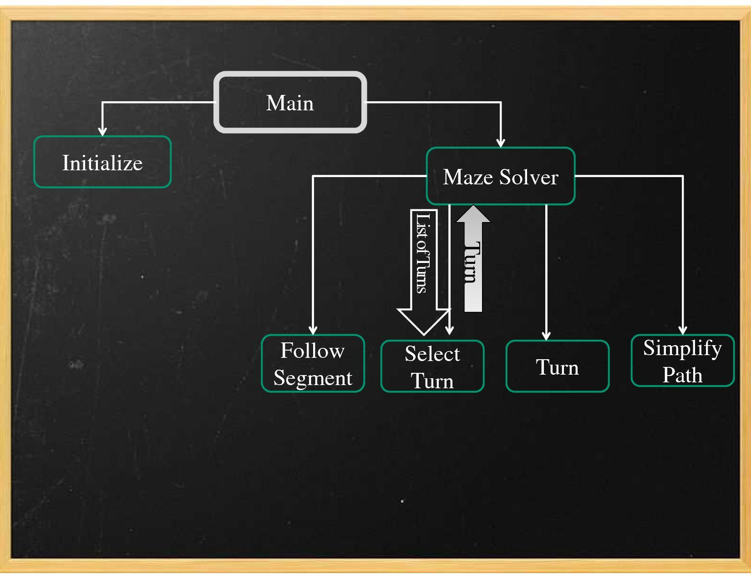
Notes:
Select turn first run is always 'L'
simplify path takes out dead ends
path and turn count are global
second run on maze solver uses an array of turns shortened by simplify_path.
One person take main, another initialize(brief description), and another maze solver. We then each take 1-2 of the remaining (select turn and turn do together).

Slide 9
Modifications
Additional code to find the fastest speed the robot can travel and still correctly take a corner.
We used #defines to make optimizing key values even easier.
Removed corner delays on second run through maze
As I'm sure at least one other team has, we added a dance at the end of the maze solver.
Working on music for finish (not start)
Notes:
Add screenshots of mods?
I'm going to put in bits of code and have the transition make it go back and forth between code and bullet point.

Slide 10
Recommendations (to-do list)
We are working on code to find the distance traveled along each straight segment so that the second run can take these at max speed, and slow to take corners.
Make transitions into turns more smooth.
For fun, add a third run measuring longitude and latitude displacement between start and finish, and use these values to make a run that skips the maze and heads straight to finish.
Add music to dance sequence, improve victory dance
Notes:
Open to more suggestions...

Slide 11
Conclusion
This project was a very informative experience which allowed us to use direct application in the area of programming.
In conclusion we are content with the results of our modifications to the maze solve code and the times to which our robot solved the maze.
Notes:
Let's take each of our conclusions. What I got won't be the same as what you got. Write your own.

